Slide 1
Serial Data Hub
(Proj Dec13-13)

Slide 2
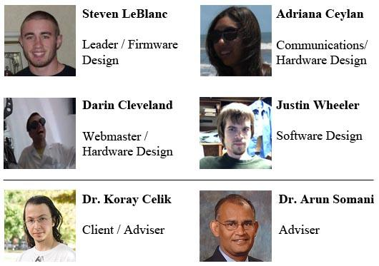
Team Members
Dec 13-13 Serial Data Hub

Slide 3
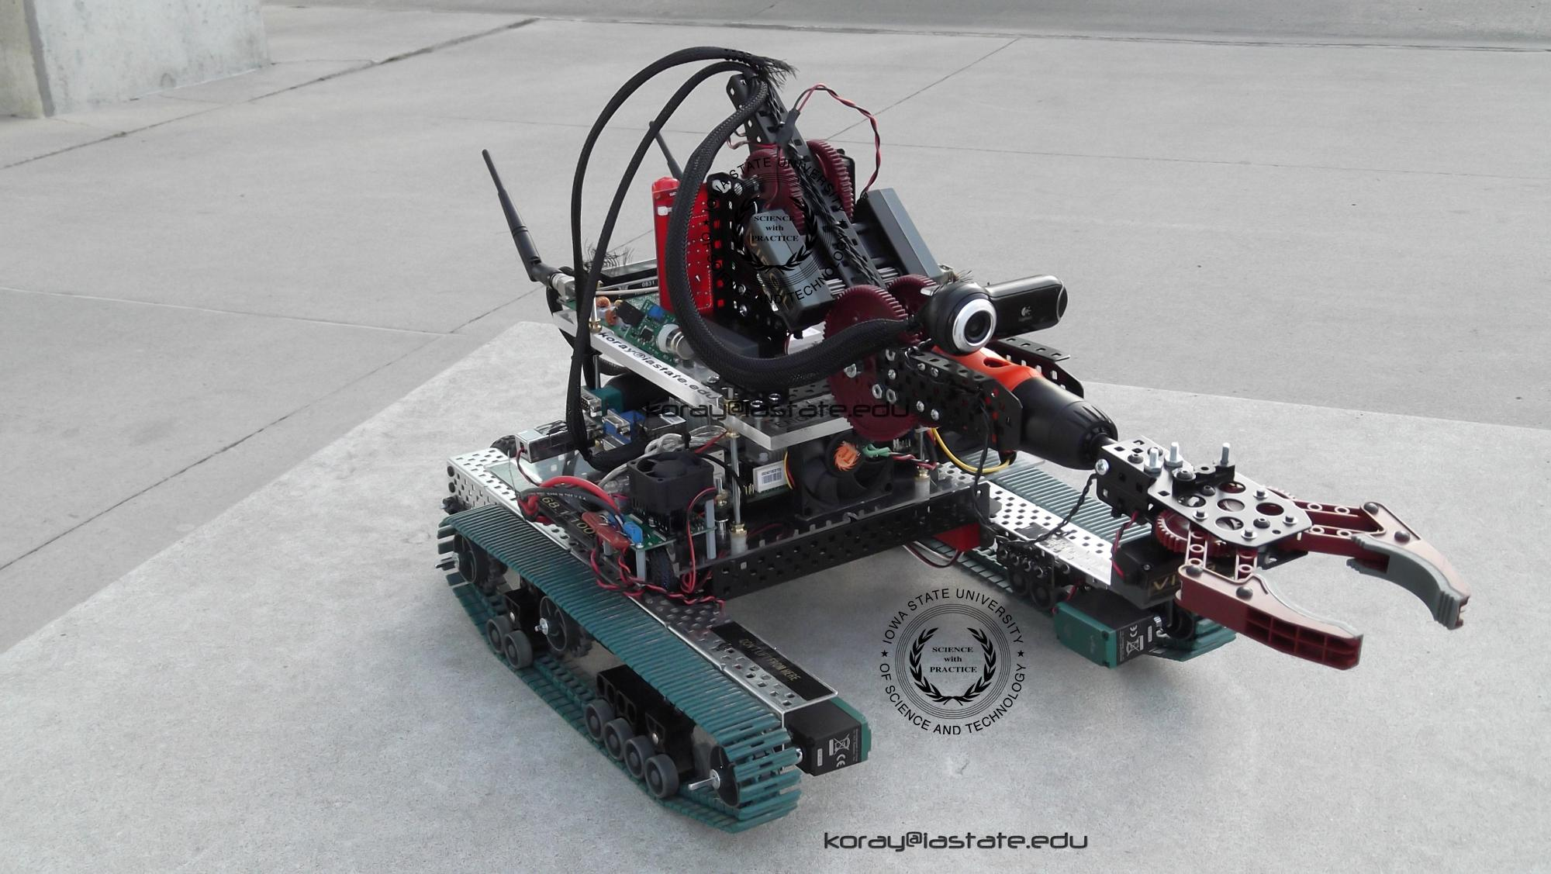
Purpose:
The client has a robot that uses up to sixteen sensors and/or motors. Each of these sensors and motors receive and send serial data, but the robot's on-board computer doesn't have enough ports to talk with all of them.
Dec 13-13 Serial Data Hub

Slide 4
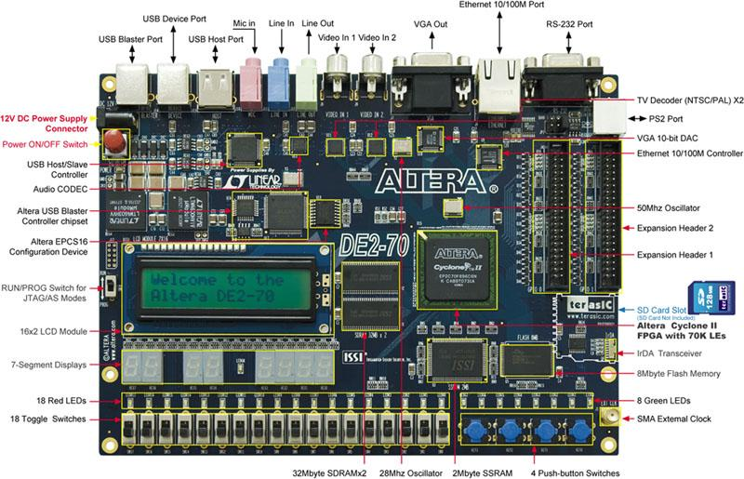
Our task was to create a Serial Data Hub, which:
Forwards data between USB and UART
Processes 16 ports of serial data in parallel through one USB connection
Decisions:
Cyclone II FPGA
DE2 Board Platform
Soft Processor and Firmware
Custom API for PC interaction
Alternative Options
Dec 13-13 Serial Data Hub
Dec 13-13 Serial Data Hub

Slide 5
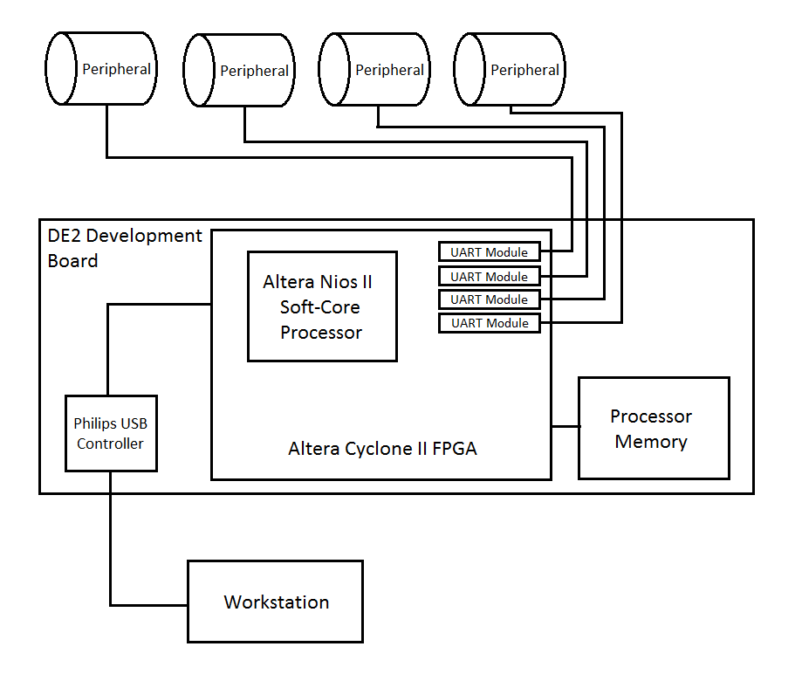
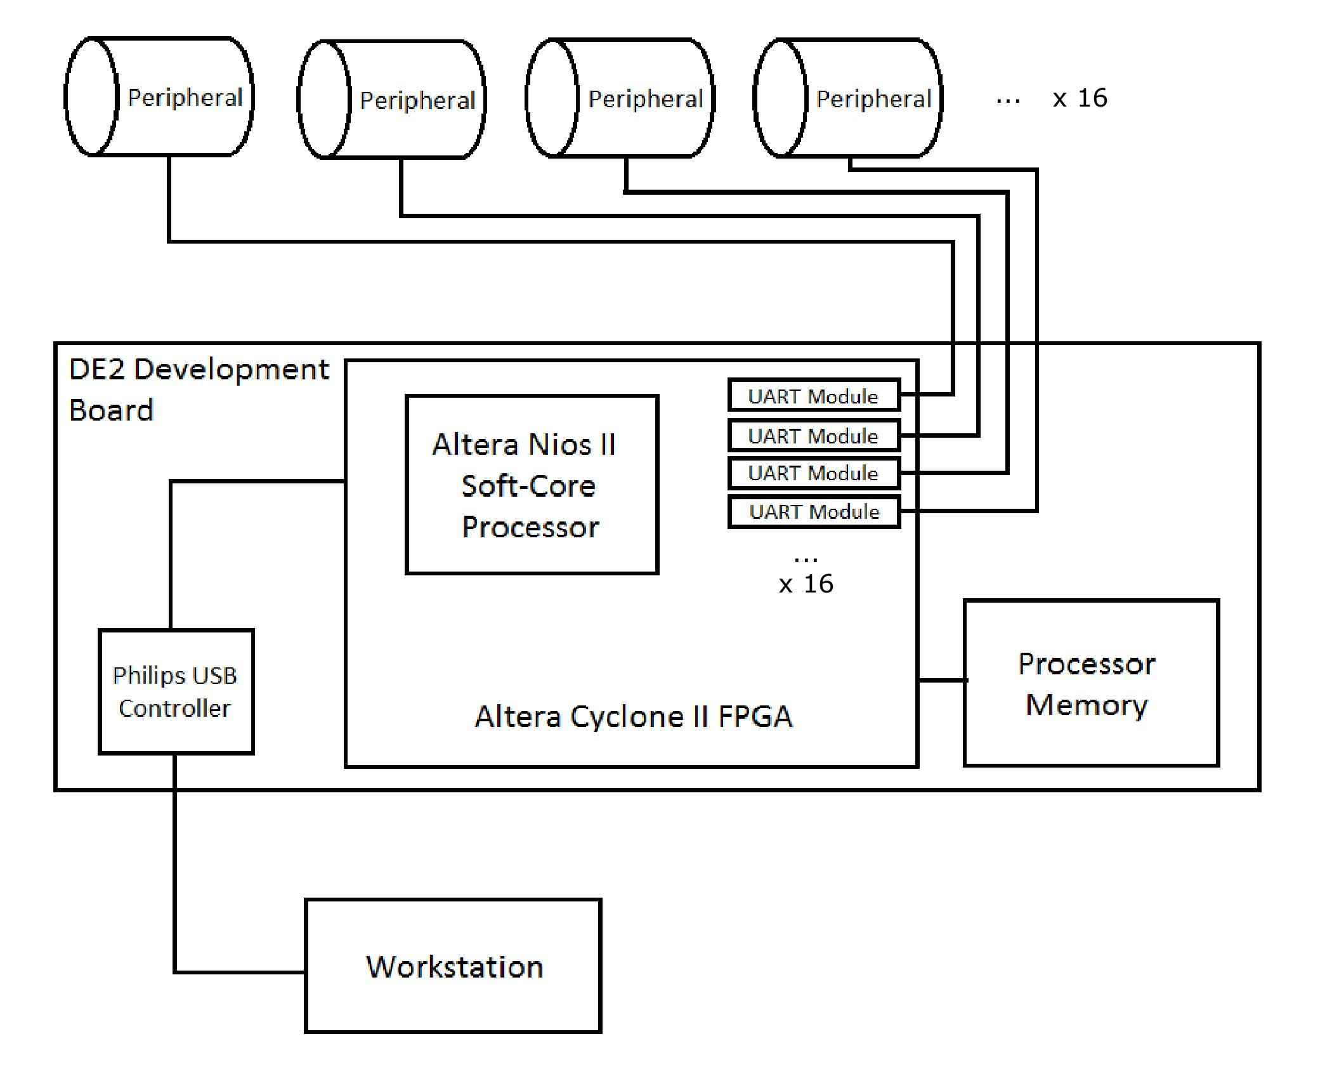
System Architecture
Dec 13-13 Serial Data Hub

Slide 6
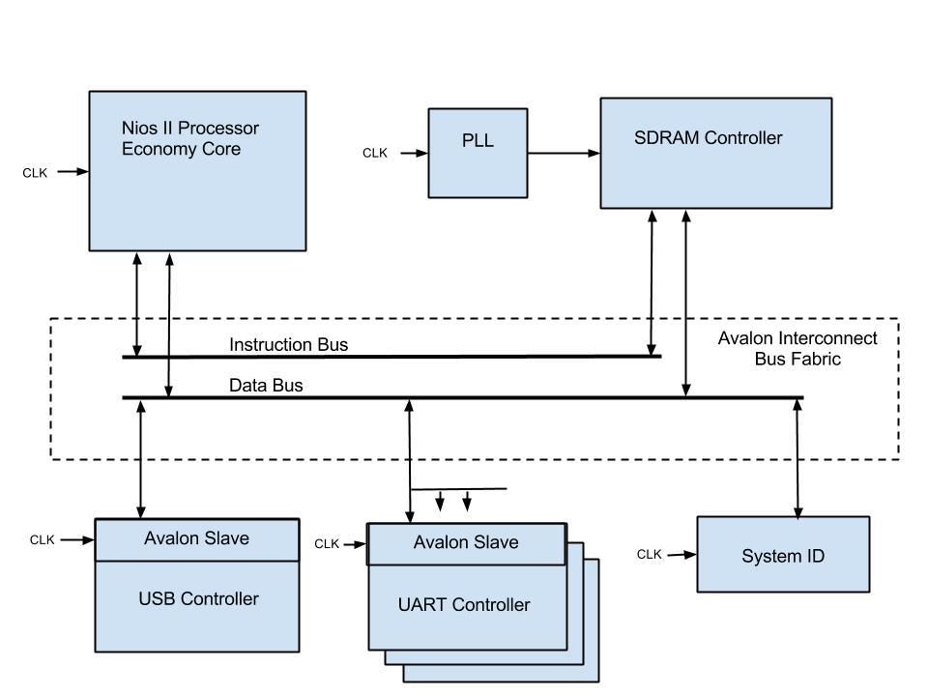
System on FPGA
Dec 13-13 Serial Data Hub

Slide 7
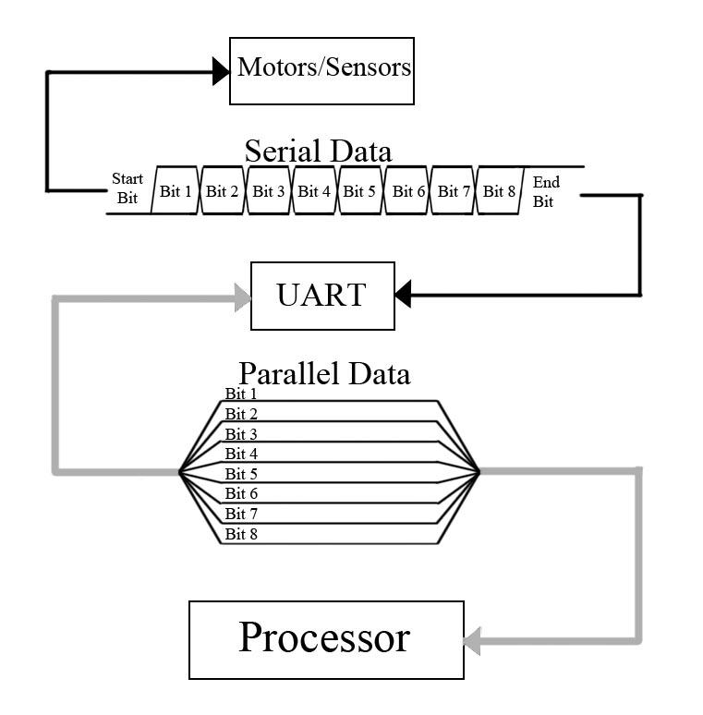
UART
The UART (Universal Asynchronous Receiver and Transmitter) is a circuit that takes parallel data and converts it to be serial data, and vice-versa. This is a crucial component to the project, as it facilitates communication between the FPGA (which takes/receives parallel data) and the motor/sensors (which takes/receives serial data).
Dec 13-13 Serial Data Hub

Slide 8
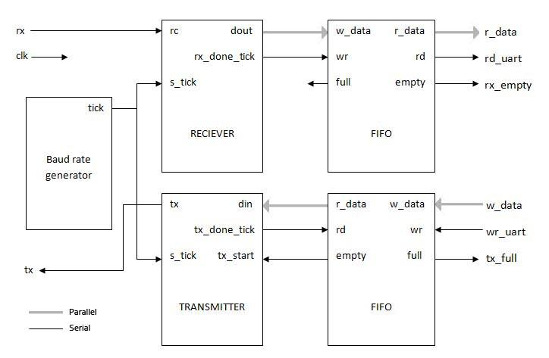
Dec 13-13 Serial Data Hub

Slide 9
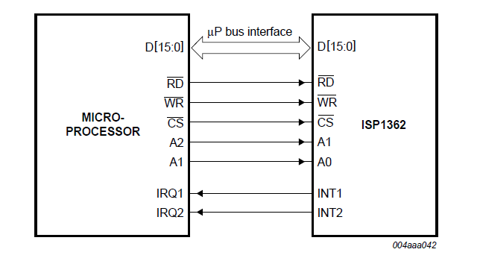
USB Controller
Communicating with separate controller
Philips ISP1362
Adapted a third party hardware module to control USB controller
Dec 13-13 Serial Data Hub

Slide 10
Software
We created an API that includes functions to:
Initialize/close connection with the device
Send data to the individual motors/sensors
Query data from the motors/sensors
Our API uses the libusb library, which contains many functions to control and communicate with USB devices.
Dec 13-13 Serial Data Hub

Slide 11
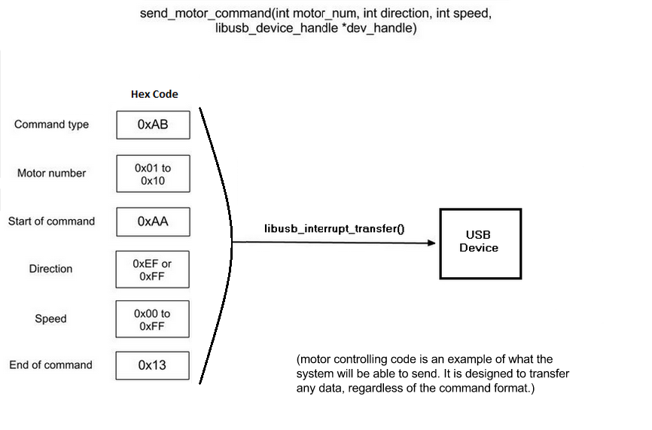
(motor controlling code is an example of what the system will be able to send. It is designed to transfer any data, regardless of the command format.)
Dec 13-13 Serial Data Hub

Slide 12
Test Plan
Hardware:
ModelSim testbench for each component
Continuously test and implement on DE2 board
Software:
PC API: Read and Write a stream of data to hardware through USB
Firmware: Start with simple tests, then work our way towards total system.
System:
Integrate hardware components in operational stages
Perform simple tests, then work our way towards testing with client’s robot.
Dec 13-13 Serial Data Hub

Slide 13
Expected Deliverables
An API containing functions to communicate with and control the device
  Should be easily modified to work with other similar devices
The completed hardware system, including 16 UARTs and an FPGA programmed to handle the inputs and outputs it is given, on a DE2 board.
All source code.
Dec 13-13 Serial Data Hub

Slide 14
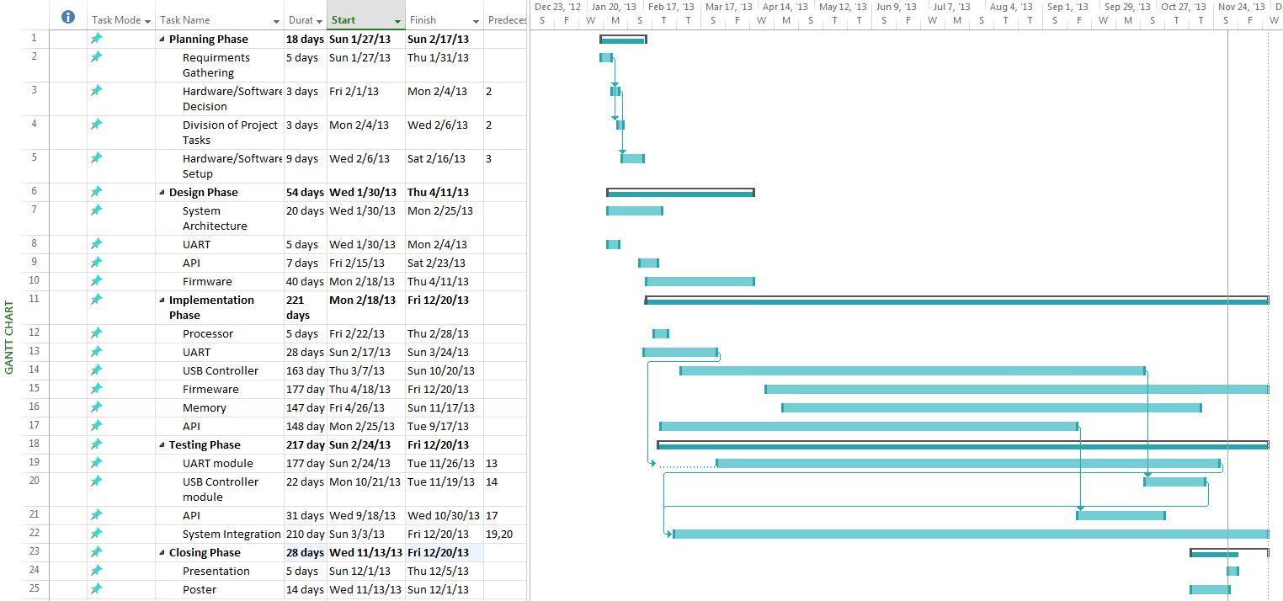
Gantt Chart
Dec 13-13 Serial Data Hub

Slide 15
Challenges to Timeline
Unclear understanding of USB devices on board
Determining best memory solution for system
Inter-chip timing issues (USB and SRAM)
Root Access to USB drivers
System integration with proprietary format
Dec 13-13 Serial Data Hub

Slide 16
Final State
Completed:
  Hardware components
    UART component
    USB controller
    processor and memory controller IP
  Software API (untested)
Uncompleted:
  Working system architecture implementation
  Threfore system testing
Dec 13-13 Serial Data Hub

Slide 17
What We Learned
Importance of architecting and appropriate interface designs
Documenting our processes (minutes, source code, install instructions, operation)
Scripted testbenches
Importances of signal timing for hardware
Version control for complex systems
Inter-chip communication: External memory, IO, clock timing
More time debugging than implementing
Dec 13-13 Serial Data Hub

Slide 18
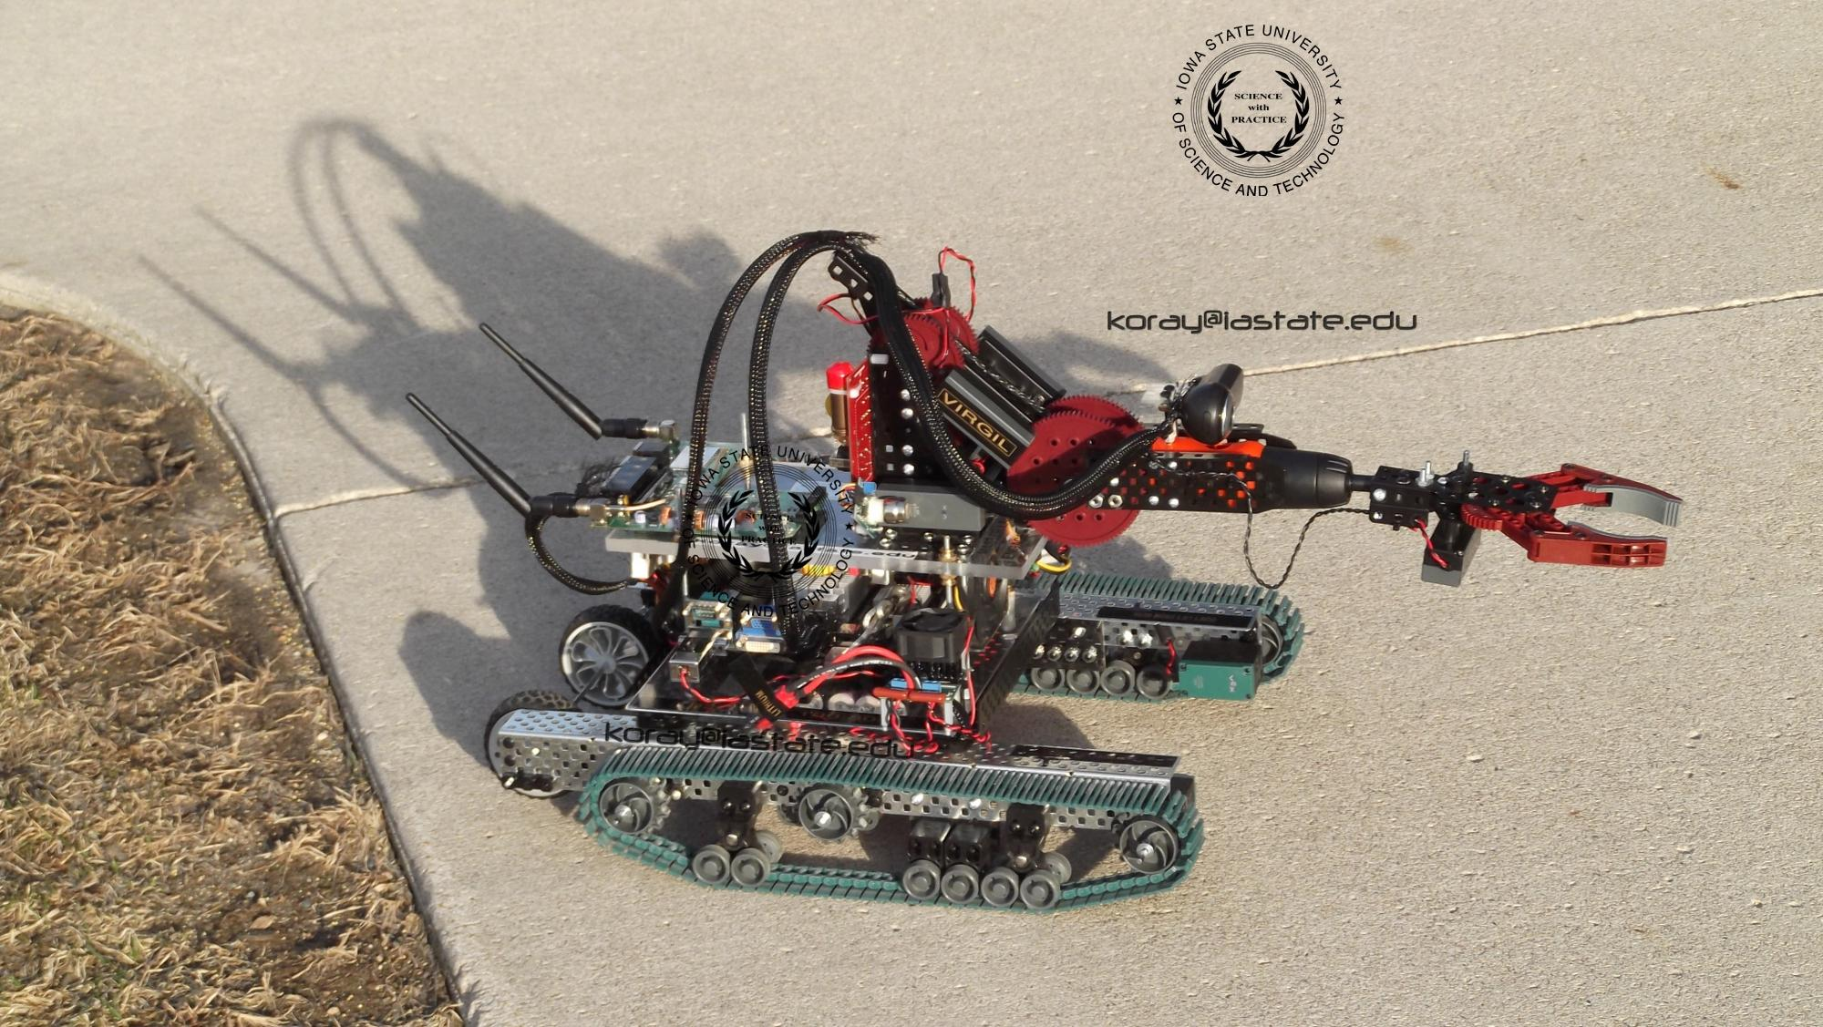
Questions?
Website: http://seniord.ece.iastate.edu/dec1313/
Dec 13-13 Serial Data Hub

